Slide 1
Data and analysis: maximising the impact of photons and neutrons
Robert McGreevy

Slide 2


Slide 3
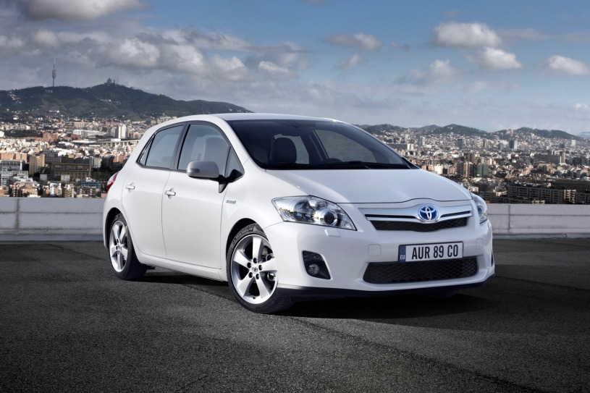
If you bought a premium-class automobile recently, ”it probably contains close to 100 million lines of software code,” says Manfred Broy, a professor of informatics at Technical University, Munich, and a leading expert on software in cars.
The world has changed …

Slide 4
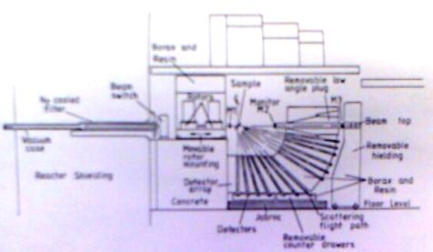
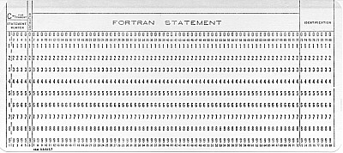
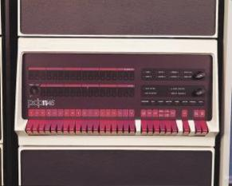

Slide 5
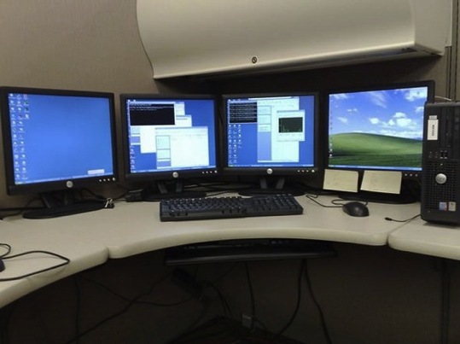
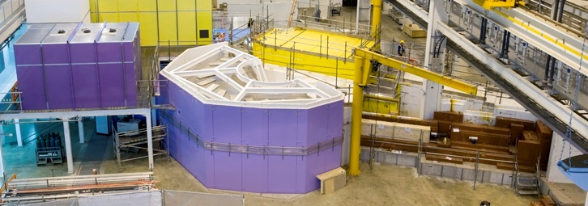

The world has changed …

Slide 6
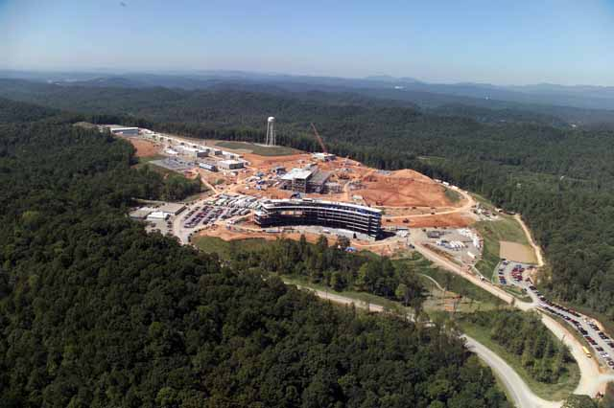
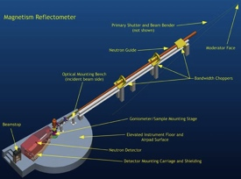


Slide 7
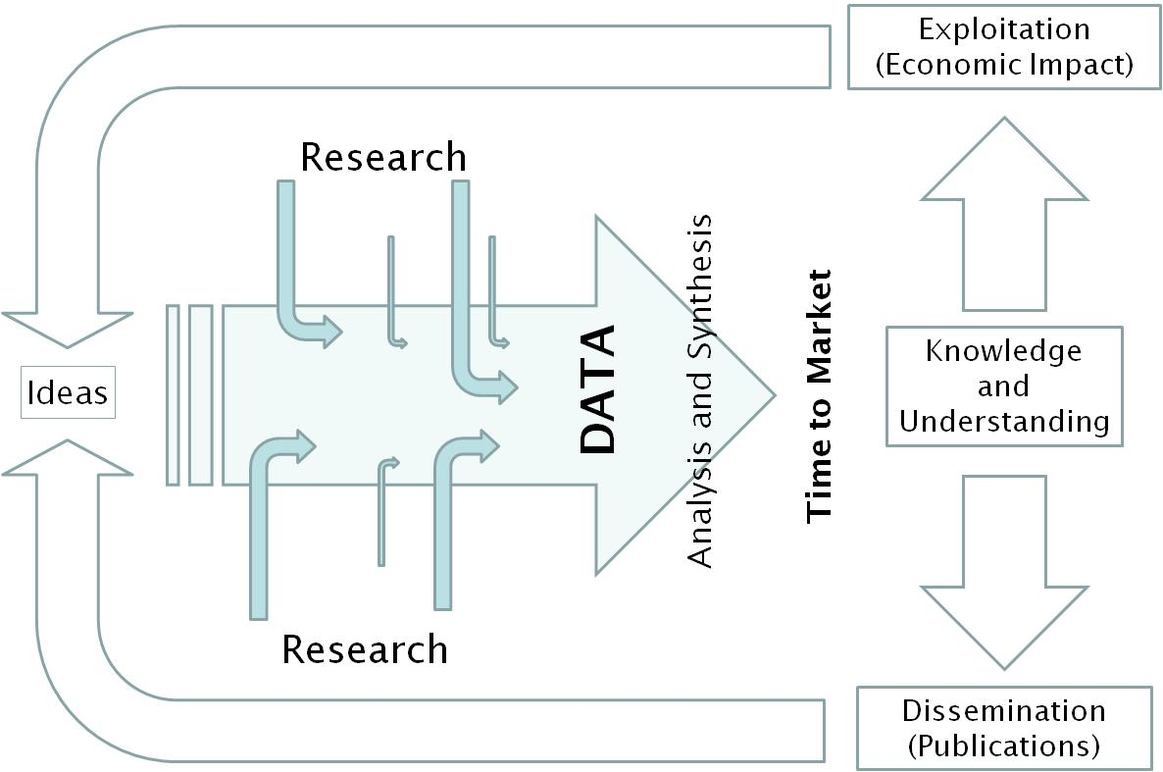

Slide 8
Data reduction (Mantid)
Data analysis and modelling (GSAS, EPSR, RMC, Tobyfit ...)
Simulation (MD, DFT ...) and theory
Data management
Instrument control and user interfaces
Instrument/source simulation
The scope

Slide 9

Currently there are more cost effective efficiency/capability gains to be made in photons and neutrons through improved software and data management than through improved sources and instruments
Most of the necessary technologies already exist, it just requires the necessary (ongoing) investment … How do we achieve this in a ‘flat cash’ world?
Most (new) users are from the iPad/Youtube generation …

